Slide 1
SEP
User Research
(Covid-19 advice web page on live website)
April 2020
Anubhav Mittal

Slide 2
Who we tested with
10 Online un-moderated test sessions, with Userzoom panel, for usability testing
Male – 4 / Female – 6
UK wide

Slide 3
What we were trying to find out
We explored the following things:
Users likes and dislikes about the homepage of findbusinesssupport.gov.scot website
If they felt there was anything missing
Their views about the Covid-19 advice web page (https://findbusinesssupport.gov.scot/coronavirus-advice) on FBS website and their likes and dislikes
Likes and dislikes specifically on the Sources of funding web pages

Slide 4
FBS homepage – likes and dislikes
When we asked the users about their likes and dislikes upon looking at the website following things were mentioned:
Top 3 likes Top 3 dislikes
1) | 2) | 3)
The information which is available | The fact that everything works and links go through | plain and simple
Clean layout | Easy to navigate | Nice use of fonts and colours
orderly | neat | tidy
I like the fact it covers COVID-19 in detail | There are very few links on the home page | The design of the page is very simple - I also like the email sign up.
Clean and not too crowded | Straightforward tone | Nothing else
Layout was simple and to the point | I could sign up to email updates on the homepage | Not too many words which makes you more inclined to read all the information on offer
depth of information available | browse help and support very useful | contact us is very easy to find
Simple | Succinct | Helpful
Bullet points on information | the events | filter area looks easy to use
The main areas of the website were divided into 4 clearly worded sections | The use of high quality images to support the texts | The simplicity of the design
1) | 2) | 3)
the fact that information that you click through to was from UK and not Scottish | was quite plain | Photo - does not depict social distancing
Boring | lack of referees | big grey space at top
The top elements listed all go to the same page which doesn’t even include all the answers you are after. eg. COVID-19 Travel is not on the follow through page | I think the top text on COVID-19 should be broken down into sections as it is quite horrible to read and view the way it is done currently | I think the website needs for options on this page.
Info looks a bit hastily assembled - not easy to navigate | Unclear logic for ordering of info | Redirects to Gov website
The cookie message blended in with the homepage | Although information was brief which I liked I could understand if others thought it wasn’t enough information | Not clear that the middle part of the website sandwiched between the top message and signing up email link are all linked
no clickable links on the list of ways you can help | signing up to email updates should say you can unsubscribe at any time
The website used large blocks of text without much thought of use of icons to help the user navigate the information with greater ease. | Video could be used to help describe what help is available to help users access the information easier. | Though the design is simple the colour scheme of the menu is also very boring to the eye.

Slide 5
FBS Covid-19 – likes and dislikes
When we asked the users about their likes and dislikes upon looking at Covid-19 information on this particular web page - https://findbusinesssupport.gov.scot/coronavirus-advice following things were mentioned:
Top 3 likes Top 3 dislikes
1) | 2) | 3)
The bottom of the page (boxes) has a clear layout | The colour scheme is nice.
The fact that there is a lot of information | I like that you can click through to further information | The topics section is very good
orderly | neat | tidy
There was a lot of information | The sentences were short and sweet | The grammar used was relatively simple and easy to understand.
Simple, clear feel | latest info at top of list | simple top FA|Qs
Had the latest information for what I can claim | Help for working flexibly | FAQ’s very appropriate to be on this page
lots of information | numerous links to click on | good to be able to browse for advice and help
Simple | To the point | Helpful
great information for people | The email updates | Broken up into sections
The second section the way the information is separated into different section makes it easy to navigate. | The page looks professional. | A wide variety of helpful topics have been covered.
1) | 2) | 3)
Looks very clumsy and unprofessional. | Text needs to be laid out differently. | Text lacks clarity.
very plain | no pictures or bright colours - not very visually interesting | first section - a bit wordy - like a foot note - I much prefer the second section with the topic sections
grey | seemed upside down useful items at bottom | looks like a website for links
I didn’t like the way there were multiple links in a sentence - I would prefer one link per section | Each sentence was trying to achieve too many things - i.e. multiple links | Some questions from the original page did not appear answered i.e. travel advice. Also some sentences were repeated , i.e. the top sentence was repeated in the first drop down question.
Info jumbled because by latest addition | hard to navigate | nothing else
Too much information on the page which is overwhleming | Not enough FAQ’s I would like to see a lot ore | The second half to the page had too much information and would be better placed on a separate page
would have liked case studies of businesses and help they can get | a what you qualify for type questionnaire would have been useful like the what you’re entitled to on benefits websites | too many links to external pages causes security concerns
Not enough bullet points | The email updates is too low down the page | Dates of info should be at the start of the info
The boring colour scheme. | The lack of images and icons to simplify the user experience. | The poor layout and formatting of the first section. The text is not easy and efficient to navigate.

Slide 6
FBS Covid-19 web page – anything missing?
Things users mentioned when asked if there was anything missing from the Coronavirus advice web page:
Top 3 things that are missing
1) | 2) | 3)
official video / adverts | Maybe contact numbers | Images/pictures
Travel Advice | If you’ve booked a holiday then what are your rights due to COVID-19 | Public transport - what to use and when. Also Funeral advice in current restrictions.
More FAQ’s | Telephone number to call for help | An online chat buddy
Elaboration of topics | Coronavirus safeguarding measures as a reminder
A sense of empathy, just a simple line saying we are here for you is nice in what is a challenging time | I couldn’t see a large search box on the page to make the information on the page easier to navigate. | Icons and images.

Slide 7
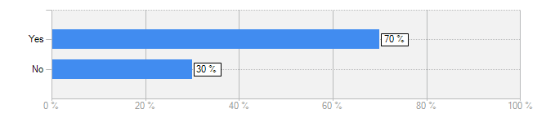
FBS Covid-19 information
Does this website cover everything that you were expecting to see about Covid-19 on this website?
Yes = 7 / No = 3
This is an emotional time for many people and important texts need to be written and presented clearly.
I would like more information around Travel advice and it doesn’t seem to answer all the questions from the home page even.
I think that the main government advertising of health awareness of Covid 19 should be included in the pages. It is official branding that most other web pages are using and it would be expected on the government website.
I would have liked to see far more FAQ’s to alleviate my concerns with regards my business and the support I could get.
It more redirects you to other websites which is fine, but they could also elaborate more on certain topics on the website itself
It provides a wealth of information and anyone would have their questions answered easily
There was a wide variety of information on the page itself and with the individual links it made it very comprehensive

Slide 8
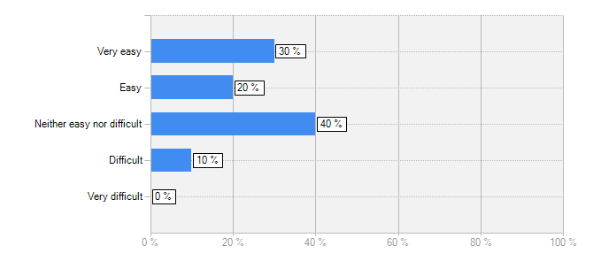
FBS Covid-19 information
How easy was it to read the content?
Answer | Count | Percent
Very easy | 3 | 30%
Easy | 2 | 20%
Neither easy nor difficult | 4 | 40%
Difficult | 1 | 10%
Very difficult | 0 | 0%
answered question | 10
I felt the grey was a downer
The text itself was easy however having multiple links per sentence tried to confuse things.
It wasn’t that easy, it didn’t flow that well and the dates should be at the start
More could be done to make it easier to read, mainly in the first section there is a lot of text the different colours and poor formatting don’t make it easy to read.
The information is very well laid out and I like that the sentences had links to take me to the sections that are relevant to me
Very well laid out and easy to read.
Very clear and simple to read

Slide 9
FBS Covid-19 information
Any thoughts on the layout of this web page, at present it contains "latest updates" at the top and then "your top questions answered" section in the middle, then "search advice by topic"?
1) | 2) | 3)
It is terrible - needs a much better design.
I thought that the search for advice by topic was the clearest and maybe best further up the page | Maybe put top questions answered at the bottom. | The latest update section could be split into headings
search advice at top | updates could be news | FAQs rather than popular
I like this layout however in my opinion it should be driven by which ever option you select on the home page , where at the moment you can only select one link. | I think the search is mostly at the top as it is on the other search page on the site. | Latest updates if urgent should be scrolling or emailed, so the sign up link should be present there too.
latest updates relate to everything so hard to find stuff relevant to me | probably the right order, though might put top questions first
The search advice topic doesn’t fit well for me here | FAQ’s need to have a lot more questions and answers | I don’t like that the cookie message blends in with the website
easy to read | follows logical order | covers most important 3 questions businesses have
The layout seems pretty straightforward
Latest updates is good at top | Email updates should be at top also

Slide 10
FBS Covid-19 information
Following comments were made when asked for ways to improve the website or to make it more efficient:
1) | 2) | 3)
Improved layout. | Better use of fonts, colours | Clearer text.
Include the government advice banners and advertising | More colour | Possibly more language options
less links more info | less grey | bit of life
Multiple entry points on home page to different COVID sections | The search should be more prominent on the COVID page | Content split into separate sections
Have a lot more FAQ’s we have tons of questions as business owners | Have a search function for questions | The page had too much text which is off putting and makes you less inclined to read it
Have safeguarding measures on the website somewhere | Make it look for government official | Elaborate on some topics on the website itself rather than just redirecting
Bullet points | Dates at start | n/a
The latest updates sectioned could be formatted in one colour the information could be written in a way that is easier to read. | There is a broad variety of content which is very helpful. | I would highlight/make obvious what financial help is available and priorities what peoples most pressing and urgent needs are and make this more prominent on the page.

Slide 11
FBS Covid-19 Sources of funding – likes and dislikes
When we asked the users about their likes and dislikes upon looking at Covid-19 information on this particular web page - https://findbusinesssupport.gov.scot/coronavirus-advice/sources-of-funding following things were mentioned:
Top 3 likes Top 3 dislikes
1) | 2) | 3)
I liked the amount of content | clearly displayed | everything links to further resources
Colour scheme is acceptable | Can navigate acceptably
neat | tidy | safe
The page has a lot of information | The page is well written | I think there is information for everyone
Clear | simple | direct
The layout was neat | I liked that it was collapable | The vast amount of relevant information was brilliant
numerous links to click on | all industries covered | it doesn’t ignore the self-employed
Clear | Simple | Helpful
A lot of information | Broken up easily for sections | Bullet points in areas for easy reading
The way the information is laid out is great. | Clearly defined headings and simple design make it easy to navigate. | The drop down bars conceal more information that you will only see fi you are looking for with more helpful links and contact numbers if needed.
1) | 2) | 3)
The layout | The design | The top light grey banner
a lot of links | very plain | undynamic
The page is rather too wordy if anything | There is so much information it could be hard to find what you are looking for | I would like a bit of a steer from the page as to what is relevant to me.
bit crowded | difficult to navigate | nothing else
a questionnaire to fill in to see what help you can get would be useful | case studies would help | a bit cluttered
Too basic | Not sure it looks like government official | Images and a more friendly design and colour scheme could be used to enhance the UX

Slide 12
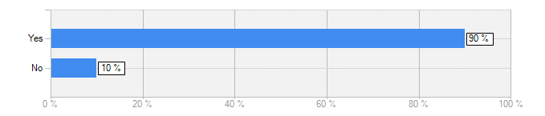
FBS Covid-19 Sources of funding
Does this section cover everything that you were expecting to see about Sources of funding advice on this website?
Yes = 9 / No = 1
Lots of really good information and links to get further information
It seems that everything is covered.
It was very well laid out and the information was vast and so relevant
Yes, very clear and covers a lot of topics
I think this info is important and is needed and fulfils questions that people would have
I would like a tool where I put in my details and the site comes back with details of what scheme and funding I am eligible for.

Slide 13
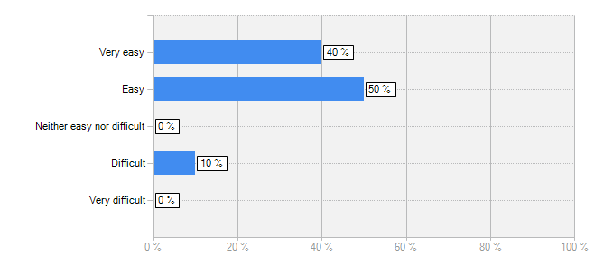
FBS Covid-19 Sources of funding
How easy was it to read the content?
Answer | Count | Percent
Very easy | 4 | 40%
Easy | 5 | 50%
Neither easy nor difficult | 0 | 0%
Difficult | 1 | 10%
Very difficult | 0 | 0%
answered question | 10
I really liked the layout of this page and the sections were easy to find
Size of text and comprehension was good.
Very clear and easy to read
It was easily broken up so flowed quite nicely
The overall menu made it easy to navigate and though there are large amounts of texts in some areas i.e. self-employed help it is specific to that area so someone looking through that section would have the patience to read through it all.
Although the content was vast it was hugely relevant
The text is not as clear as I would like it to be, but it is acceptable.

Slide 14
FBS Covid-19 information
Any thoughts on the layout of this web page, this could be around the way each item is displayed etc.?
1) | 2) | 3)
I really liked the simplicity | again - maybe the government advertising / warning messages could be incorporated | I preferred this page from the first home page - I thought that it was very clear
It looks a bit unprofessional | Needs better use of colour, fonts
drop down useful | very hard on eyes | too many links
I would prefer a funding tool for my situation | If not then I would prefer a search | The layout that is current is my least preferred option
I liked the concise layout | I liked that the arrows expanding the information needed | N/A
well laid out | like the arrows to open up more content | site is easy on the eye
Good layout, clear and easy to find information | The menu navigation system is great. | The text could potentially be broken up but because it so well categorised it’s not necessary to format it further.
Could have some images | A lot of white

Slide 15
Thank you!

